Slide 1
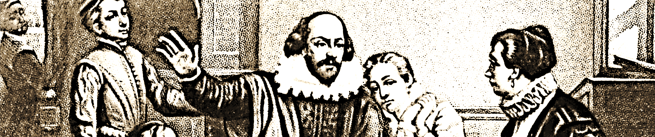
My solution for Historial Figures take 2
Notes:
QuickStarter has created an outline to help you get started on your presentation. Some slides include information here in the notes to provide additional topics for you to research.
More key facts:
Academic conference: AAAI 2016, NIPS 2015, ICML 2016, IJCAI 2016, KDD 2016, CVPR 2016, ICASSP 2016, ICDM 2015, ACL 2016, CHI 2016, European Conference on Artificial Intelligence (ECAI) 2016, WWW 2016, CIKM 2015, ICPR 2016, UAI 2015, SIGIR 2016, IJCNN 2015, ECCV 2016, ICCV 2015, ICIP 2015, GECCO 2016, LREC 2016, ICRA 2016, AAMAS 2016, COLING 2014, IROS 2015, ICANN 2014, EMNLP 2015, SDM 2016, IEEE SMC 2016, PAKDD 2016, Interspeech 2015, EACL 2014, IEEE CEC 2015, ICME 2016, NAACL 2016, COLT 2015, ICMLA 2015, ICDE 2016, VLDB 2015, SIGMOD 2016, ICONIP 2015, ICC 2016, SIGGRAPH 2015, MICCAI 2015, WSDM 2016, GLOBECOM 2015, STOC 2016
Popular online courses: Machine Learning (MIT), Machine Learning (Stanford University), Prediction: Machine Learning and Statistics (MIT), Practical Machine Learning (Johns Hopkins University), Neural Networks for Machine Learning (University of Toronto), 機器學習基石 (Machine Learning Foundations) (National Taiwan University), Distributed Machine Learning with Apache Spark (University of California, Berkeley), 機器學習技法 (Machine Learning Techniques) (National Taiwan University)

Slide 2
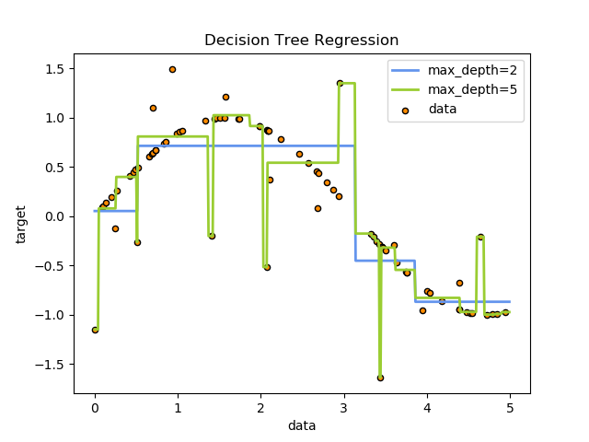
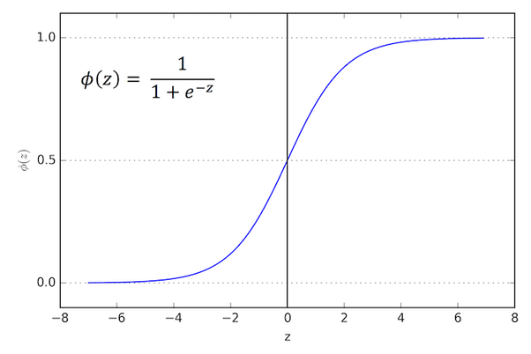
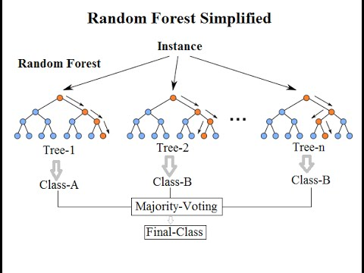
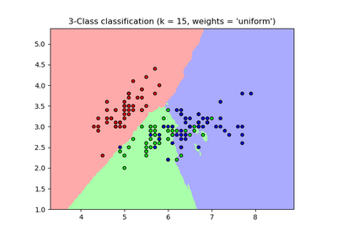
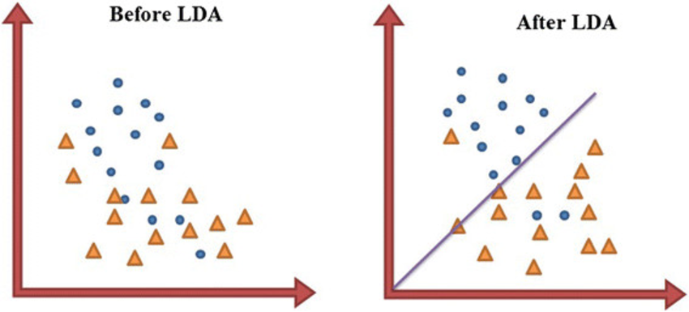
Models
LogisticRegression:
LinearDiscriminantAnalysis
KNeighborsClassifier:
DecisionTreeClassifier
BernoulliNB:
RandomForestClassifier
AdaBoostClassifier
MLPClassifier
SVR

Slide 3
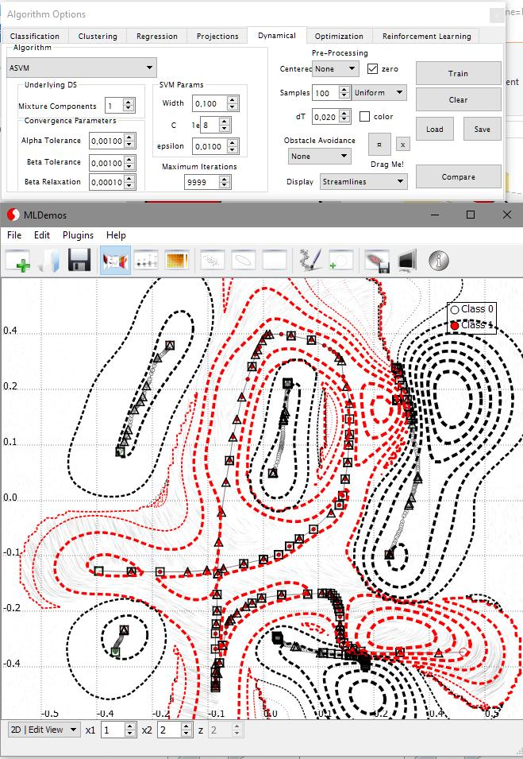
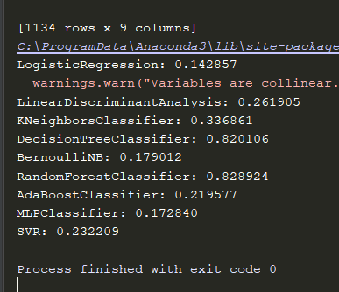
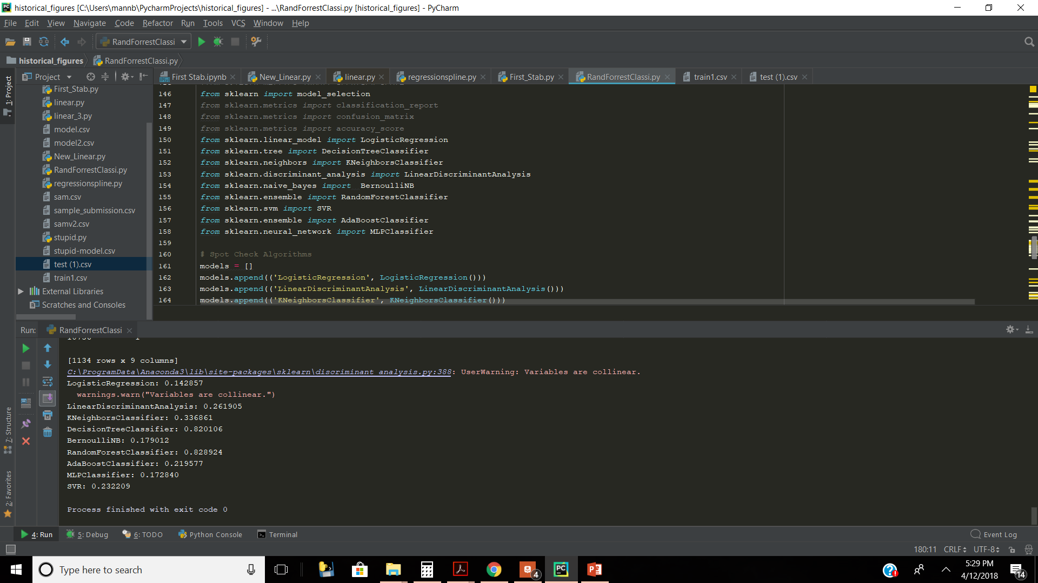
Machine learning Model Results

Slide 4
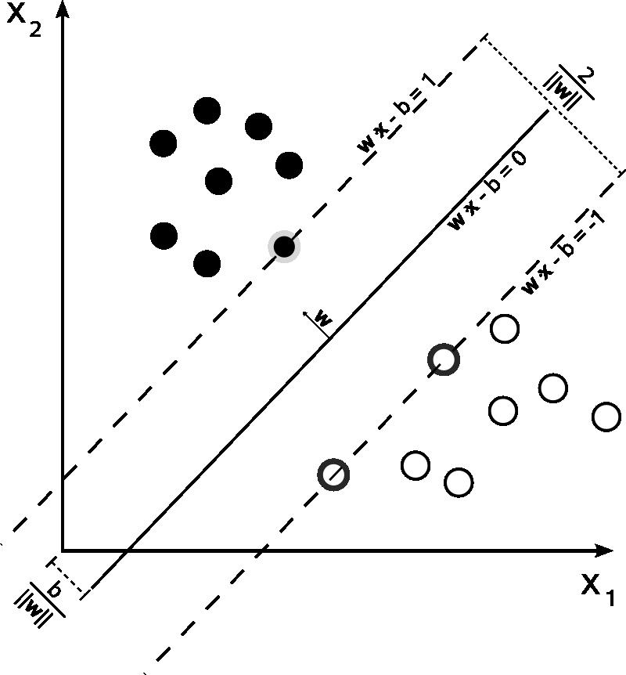
Data
How I manipulated the data
Notes:
Consider talking about:
Machine learning tasks
Machine learning applications

Slide 5
“Insanity: doing the same thing over and over again and expecting different results.”-Albert Einstein
Notes:
Consider talking about:
Relation to statistics

Slide 6
“Imagination is more important than knowledge.” -Albert Einstein
Notes:
Consider talking about:
Relation to statistics

Slide 7
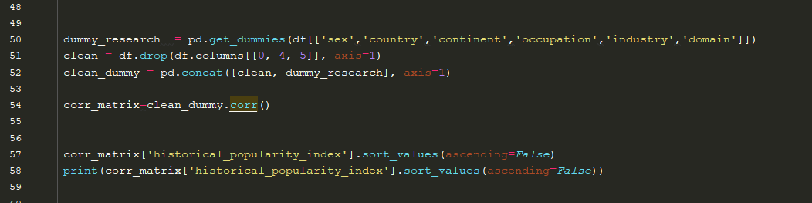
Finding Data

Slide 8
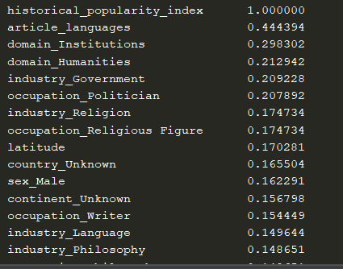

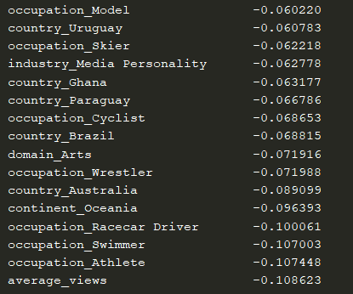

Data Results

Slide 9
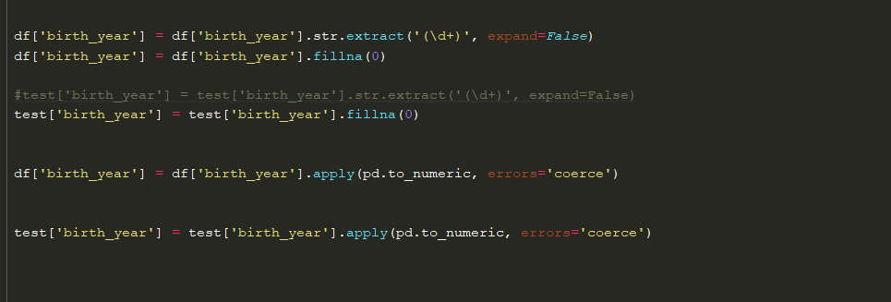
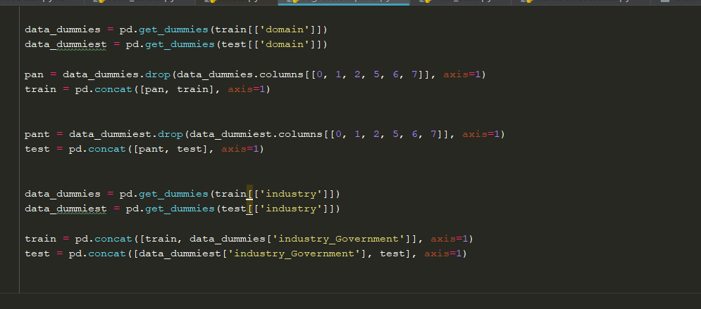
Data I used to train

Slide 10
